Slide 1

CRM Sales Data Challenge
Student final dashboards
Trainer: Anh Leimer Training Assistants: Hanna Nguyen, Trang Tran & Hien Tran

Slide 2
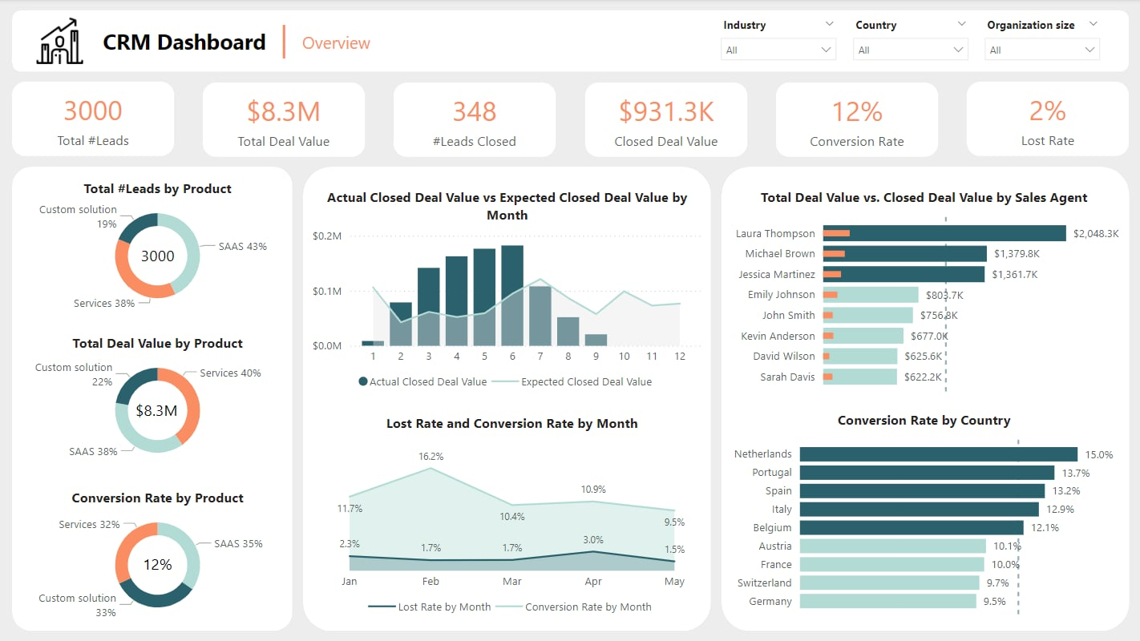
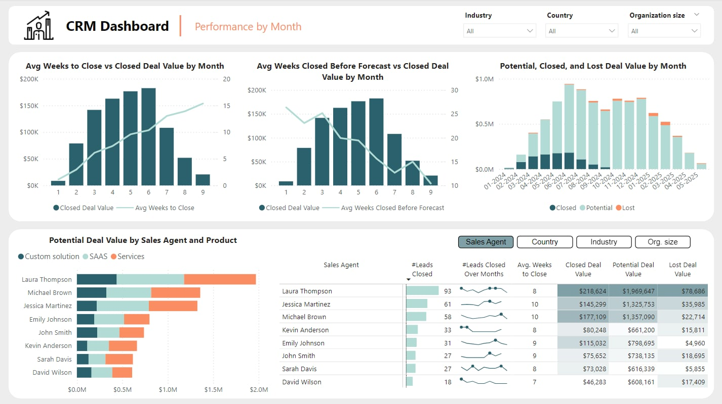
CRM Sales Dashboard – FP20 Data Challenge
Link to Linkedin post by Trang Tran
This dashboard was selected as Silver Winner of the Challenge!

Slide 3
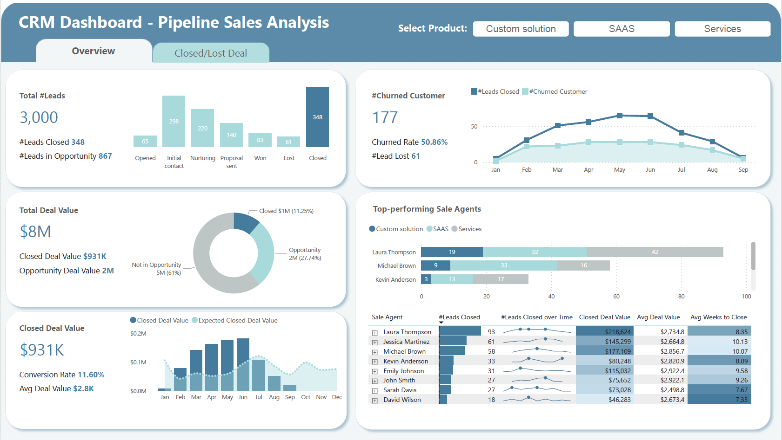
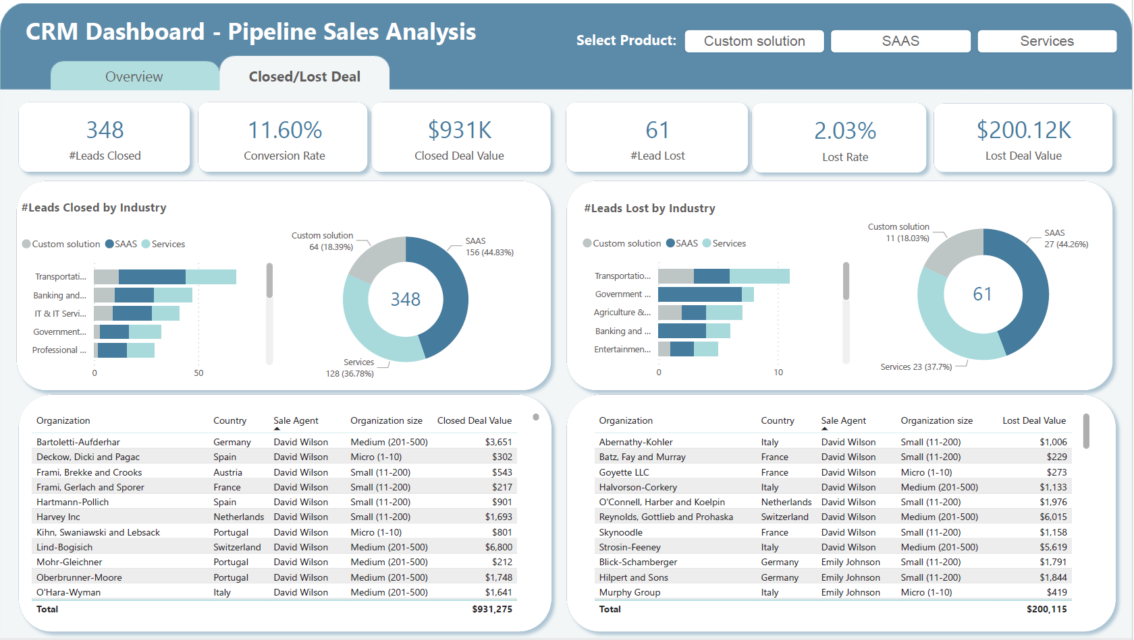
CRM Sales Dashboard – FP20 Data Challenge
Link to Linkedin post Duy Thanh Vuong

Slide 4
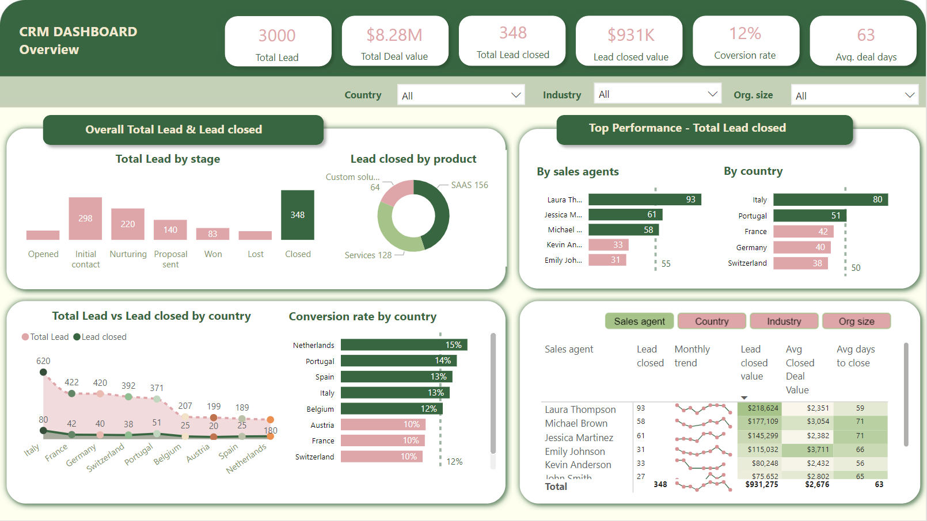
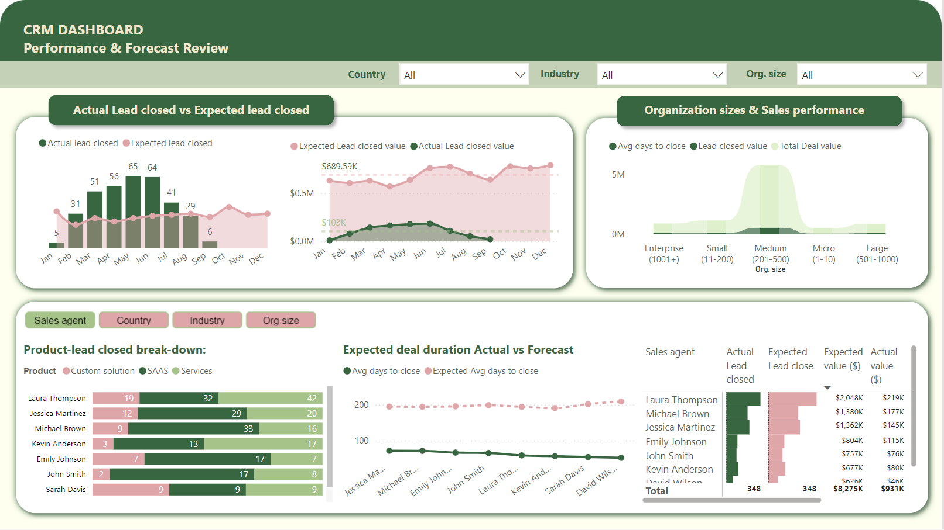
CRM Sales Dashboard – FP20 Data Challenge
Link to Linkedin post by Hanna Nguyen

Slide 5
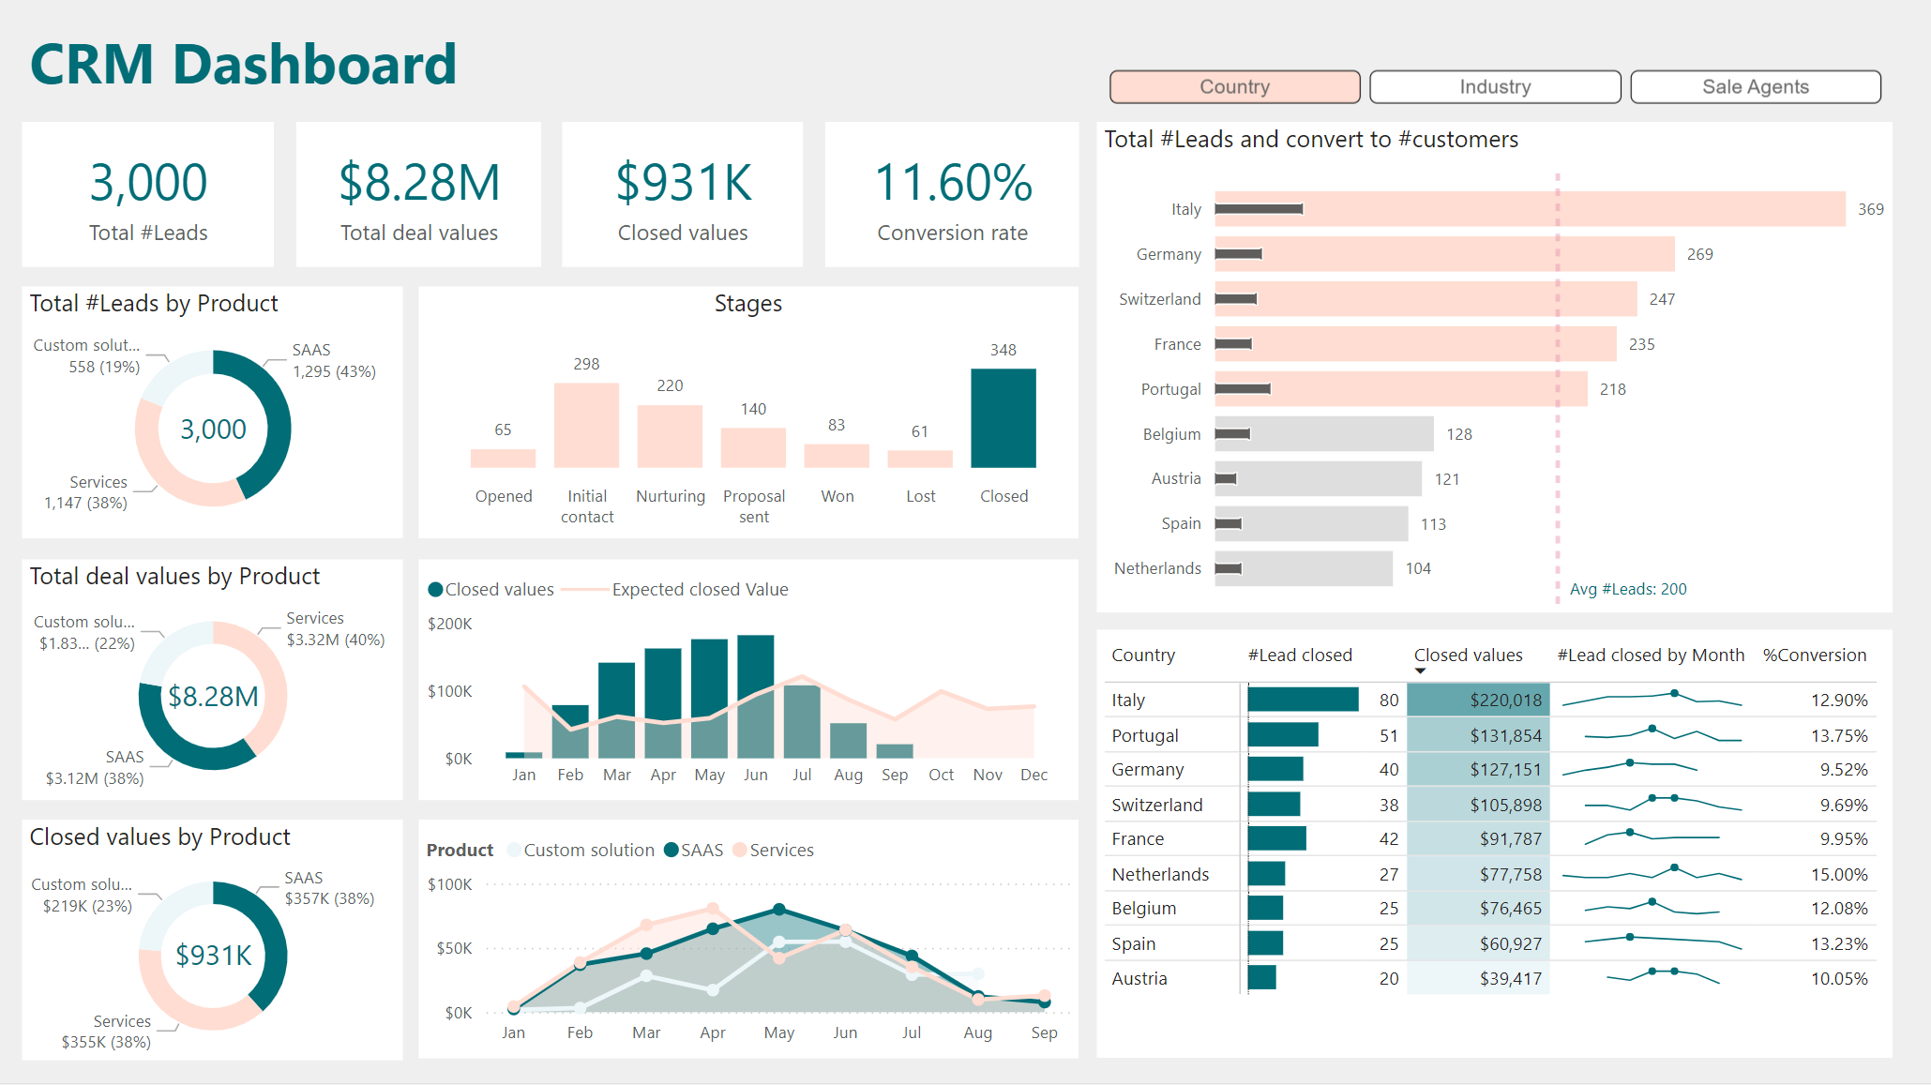
CRM Sales Dashboard – FP20 Data Challenge
Link to Linkedin post by Y Platek

Slide 6
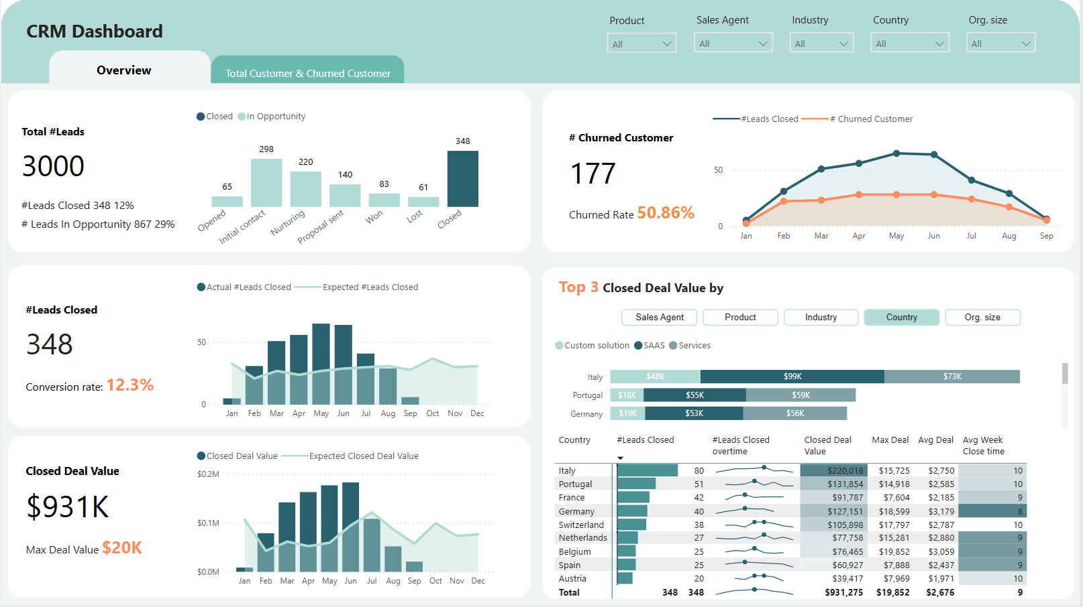
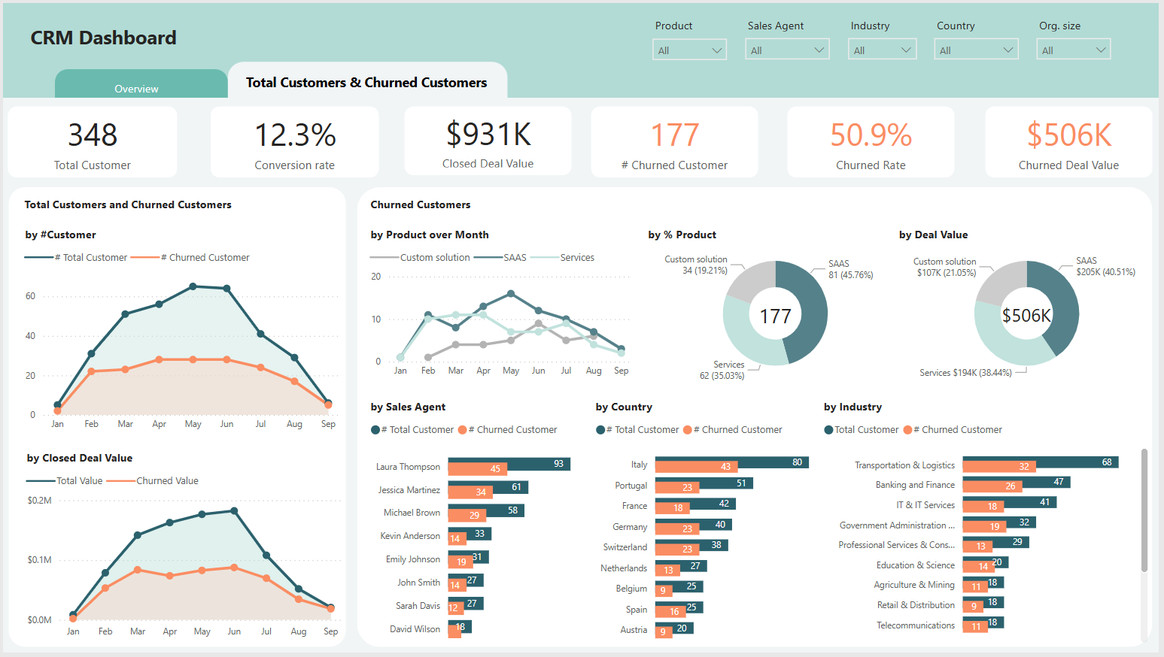
CRM Sales Dashboard – FP20 Data Challenge
Link to Linkedin post by Thu Hong Nguyen

Slide 7
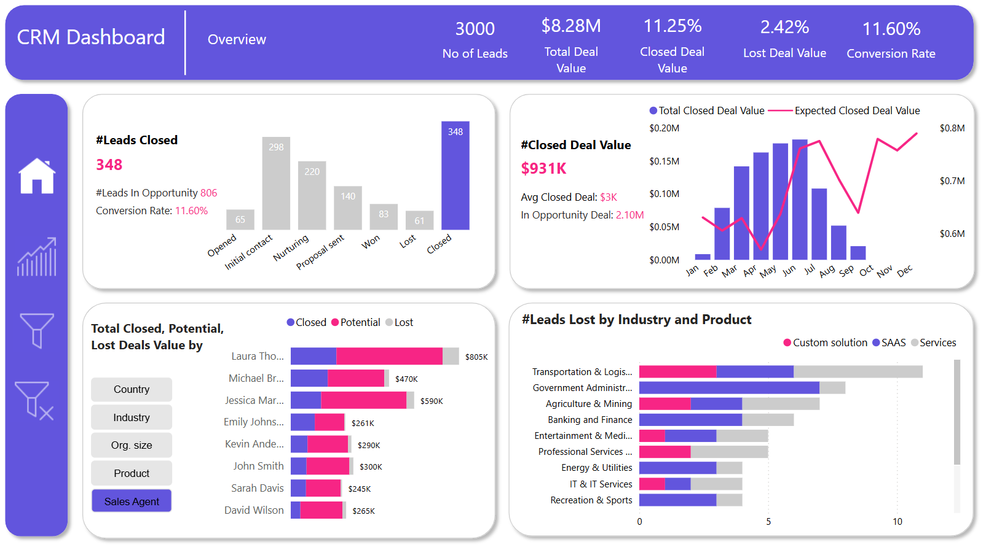
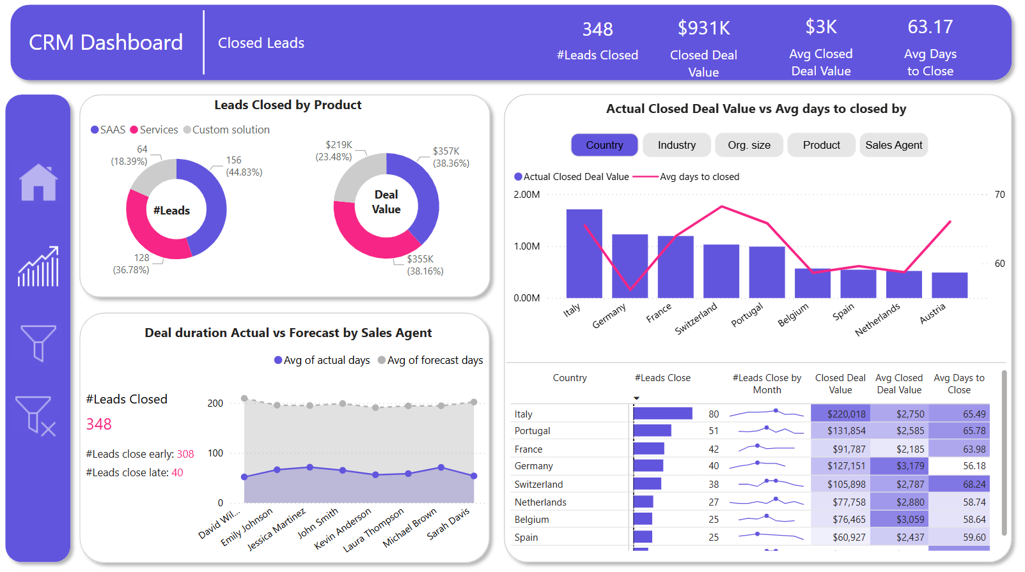
CRM Sales Dashboard – FP20 Data Challenge
Link to Linkedin post by Julia Nguyen

Slide 8
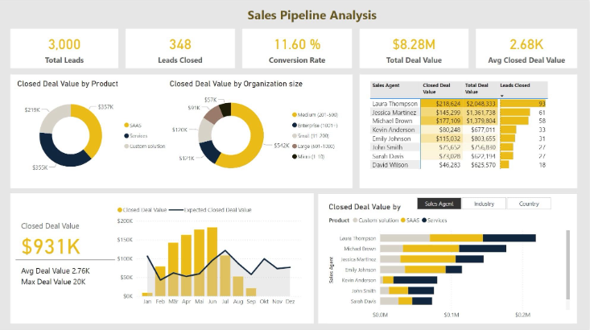
CRM Sales Dashboard – FP20 Data Challenge
Link to Linkedin post by Ni Vu

Slide 9
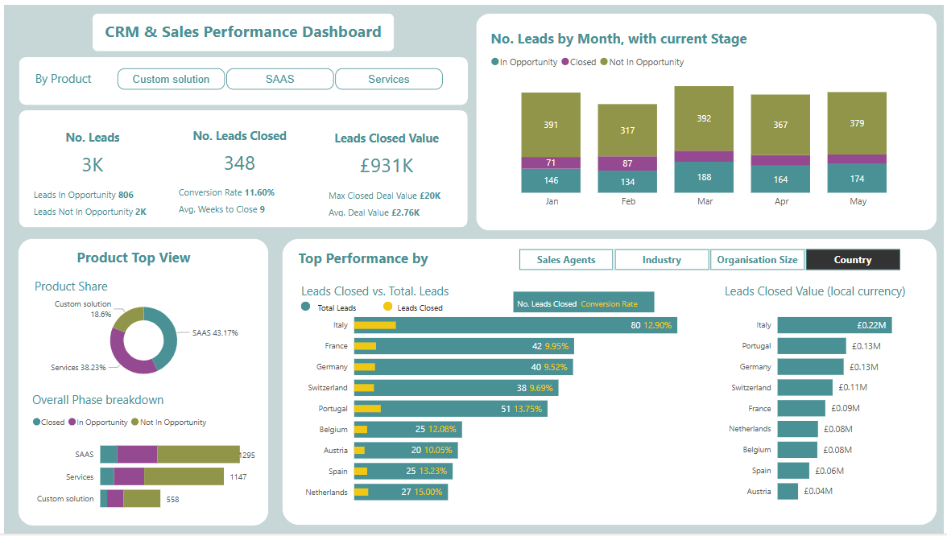
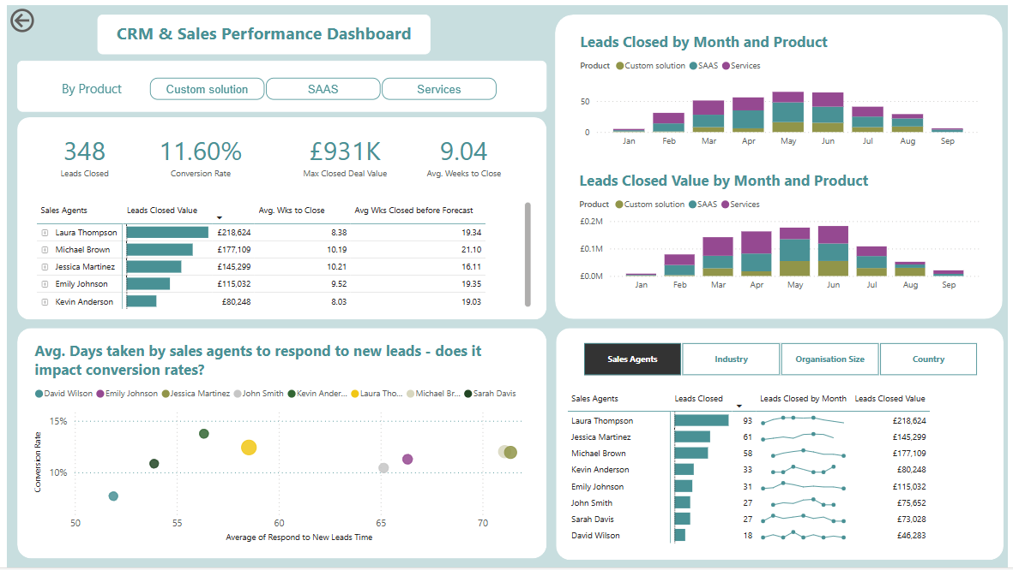
CRM Sales Dashboard – FP20 Data Challenge
Link to Linkedin post by Kim Hoa Nguyen

Slide 10
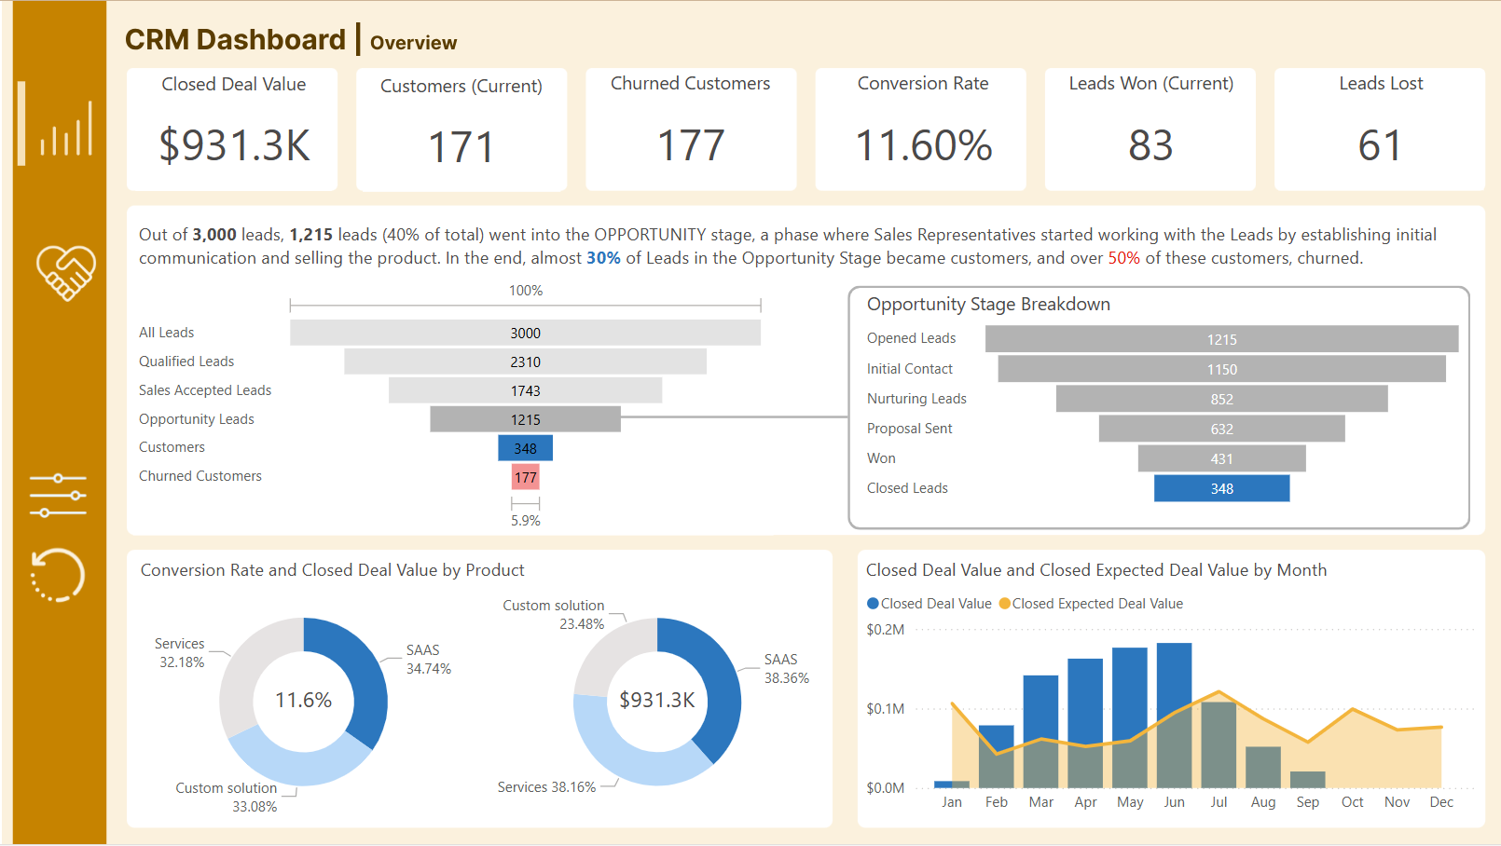
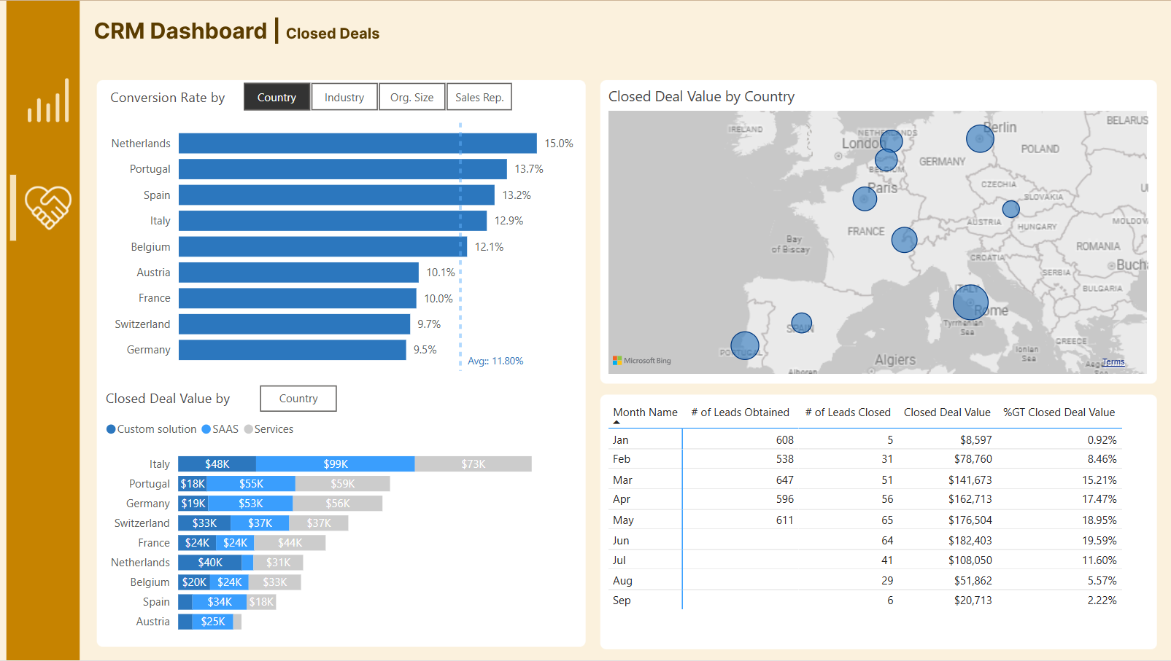
CRM Sales Dashboard – FP20 Data Challenge
Link to Linkedin post by Blessing Jegede

Slide 11
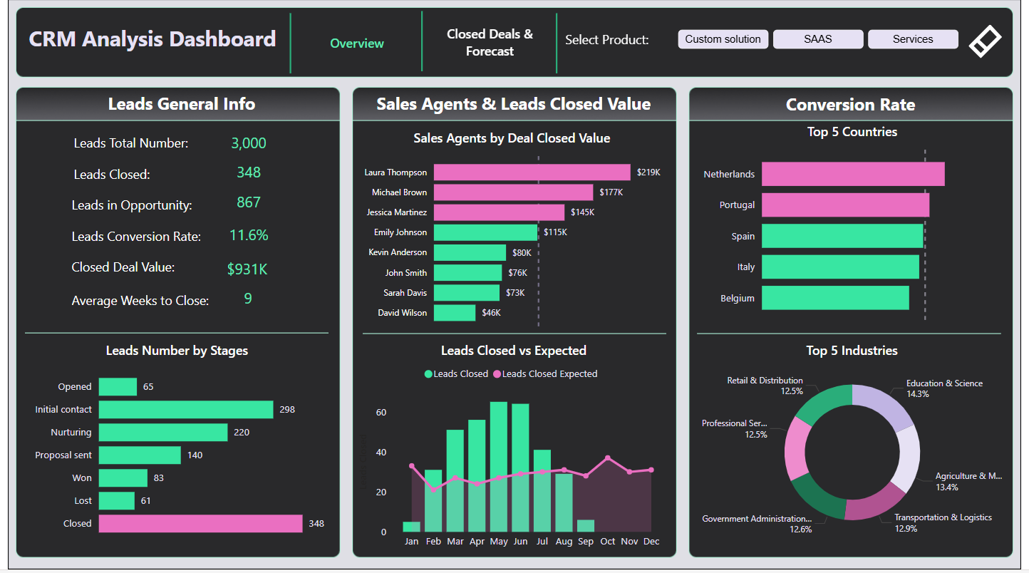
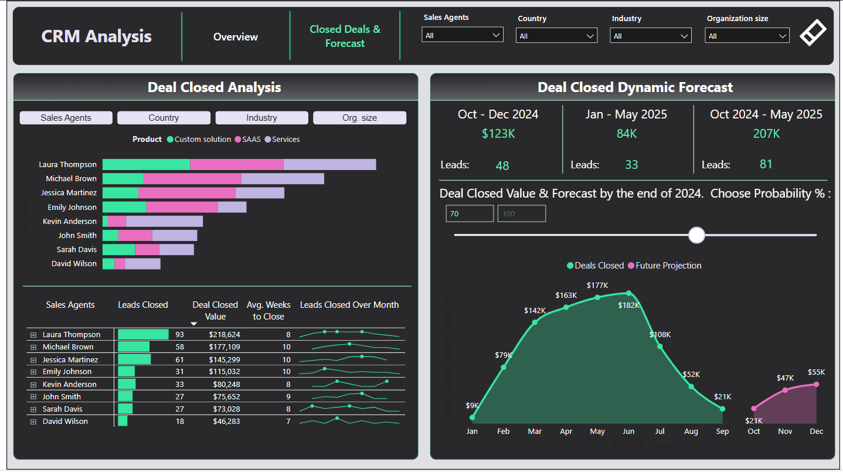
CRM Sales Dashboard – FP20 Data Challenge
Link to Linkedin post by Borys

Slide 12
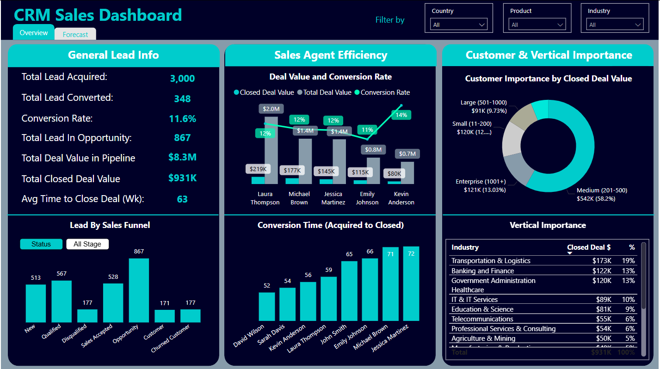
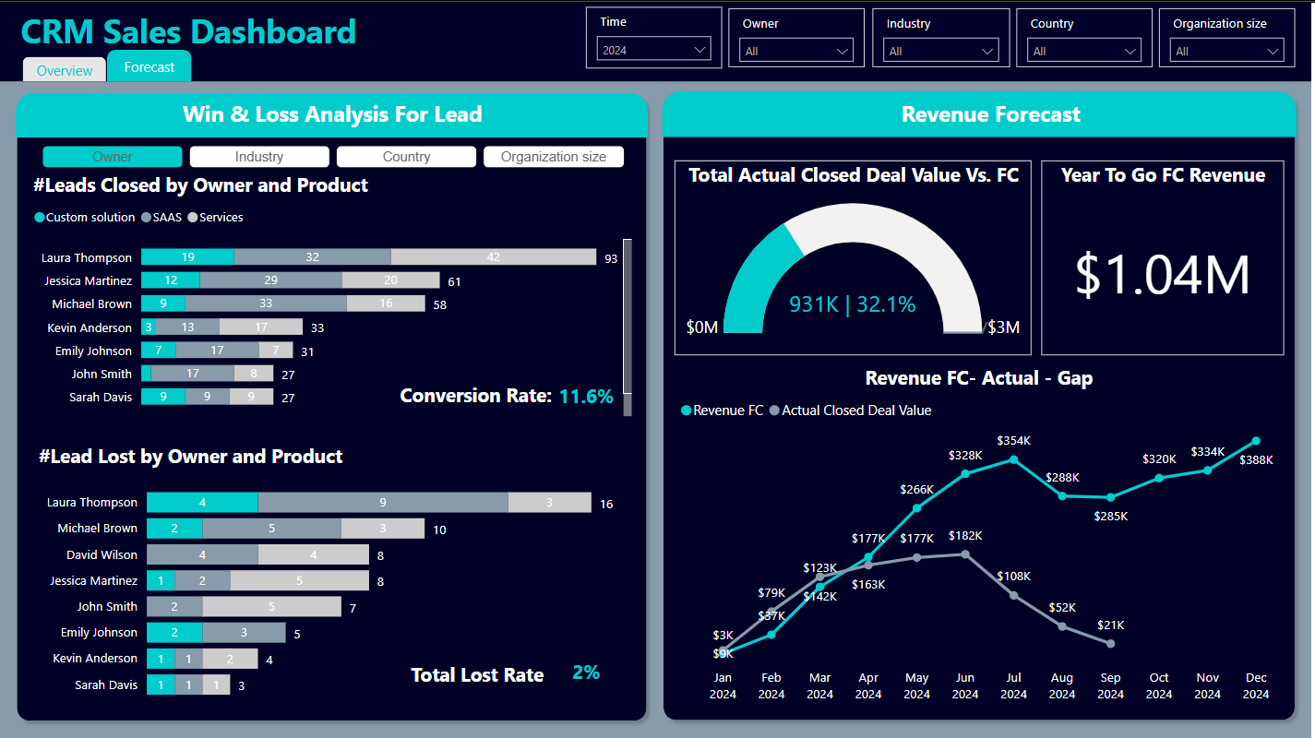
CRM Sales Dashboard – FP20 Data Challenge
Prepared by Hao Tran

Slide 13
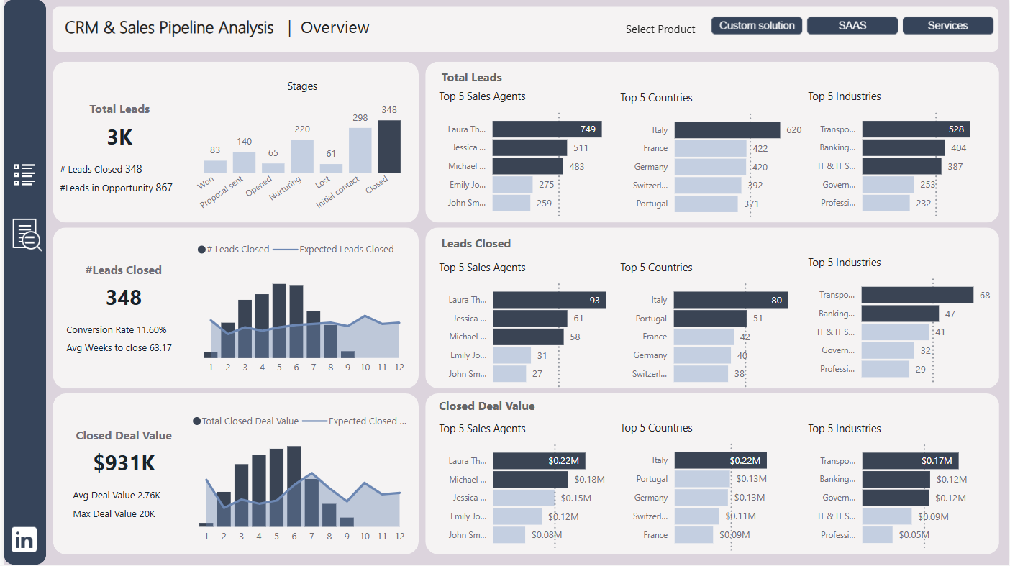
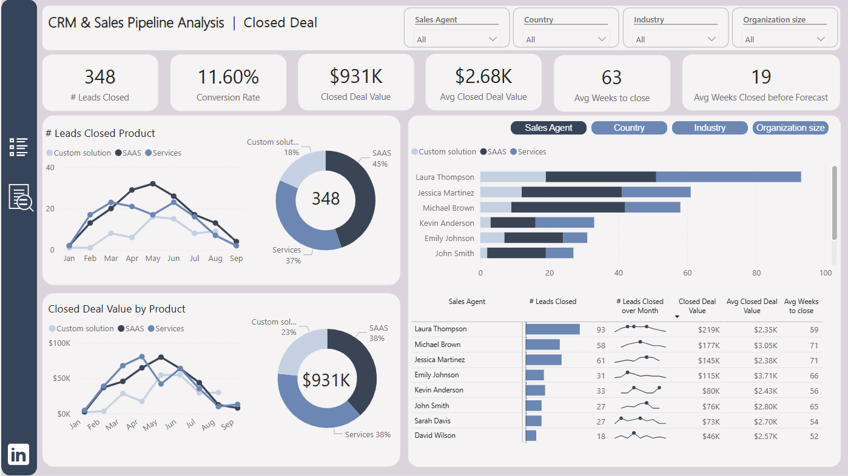
CRM Sales Dashboard – FP20 Data Challenge
Link to Linkedin post by Hang Tran

Slide 14
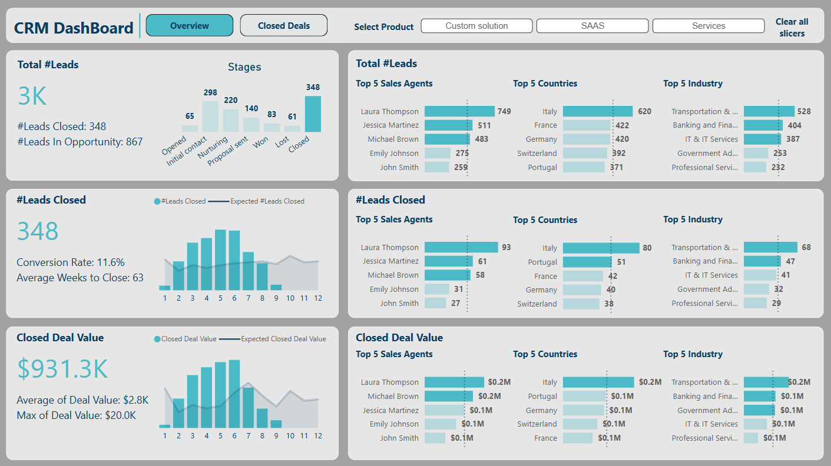
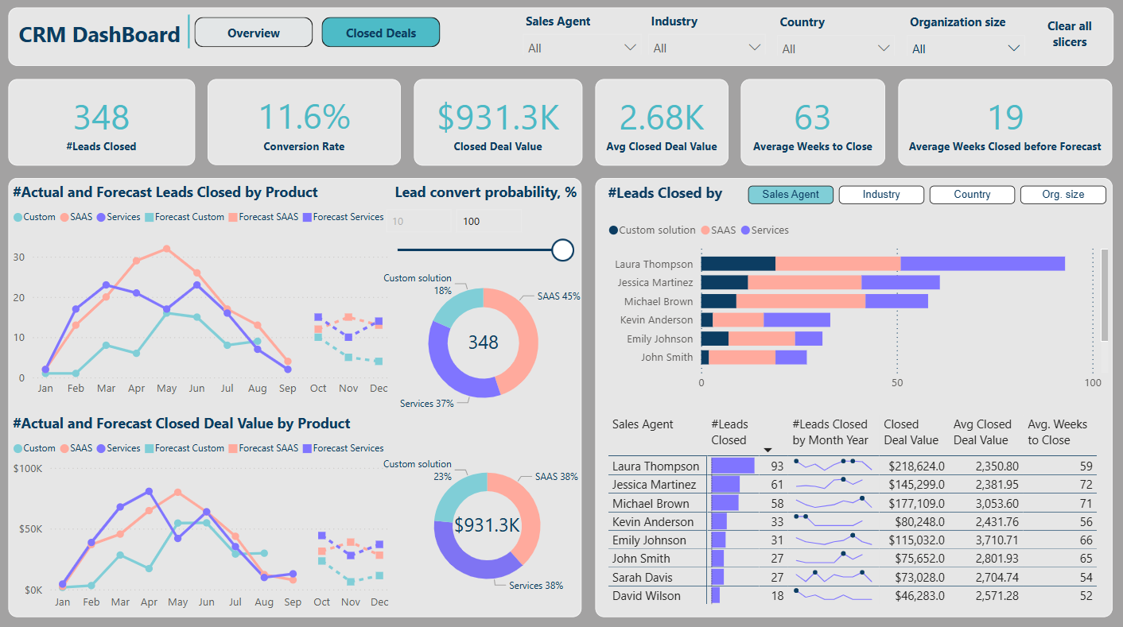
CRM Sales Dashboard – FP20 Data Challenge
Link to Linkedin post by Anh Duy Vu

Slide 15
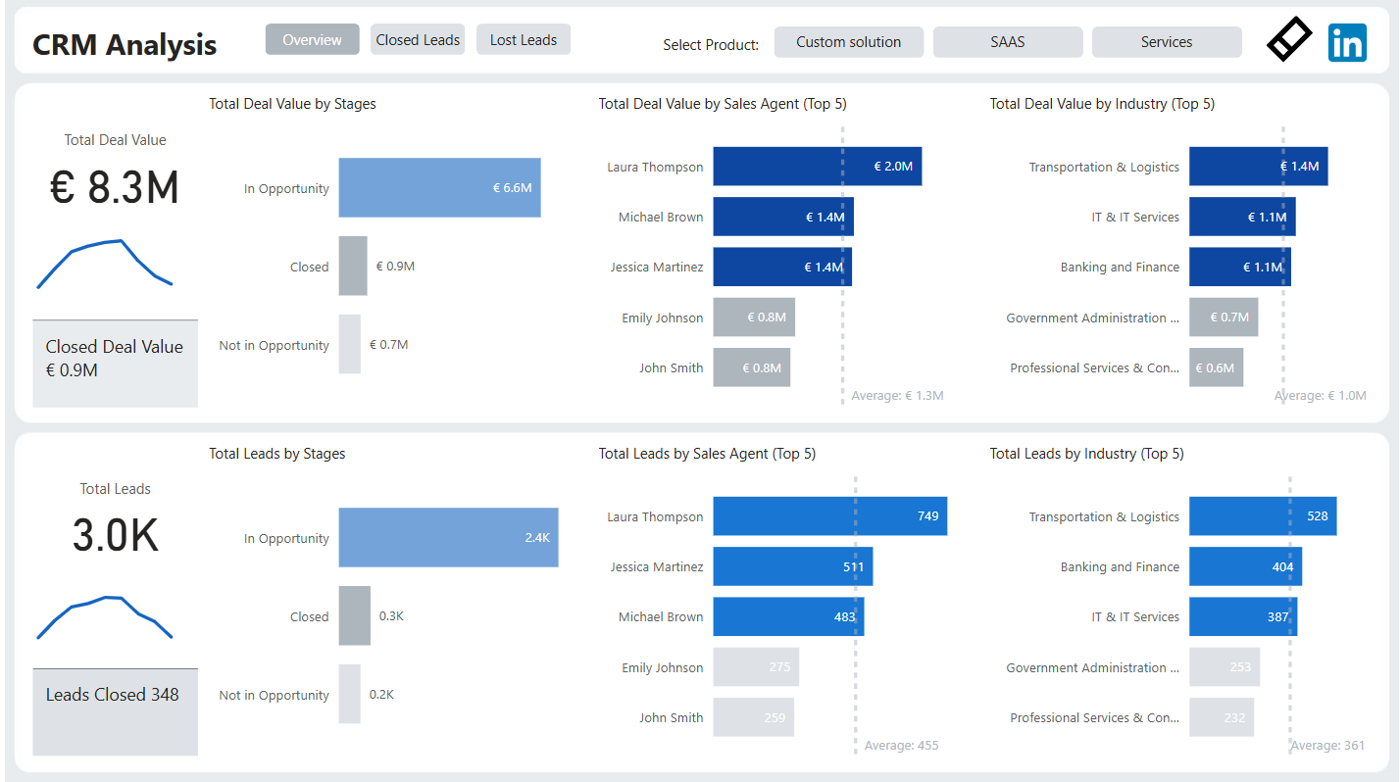
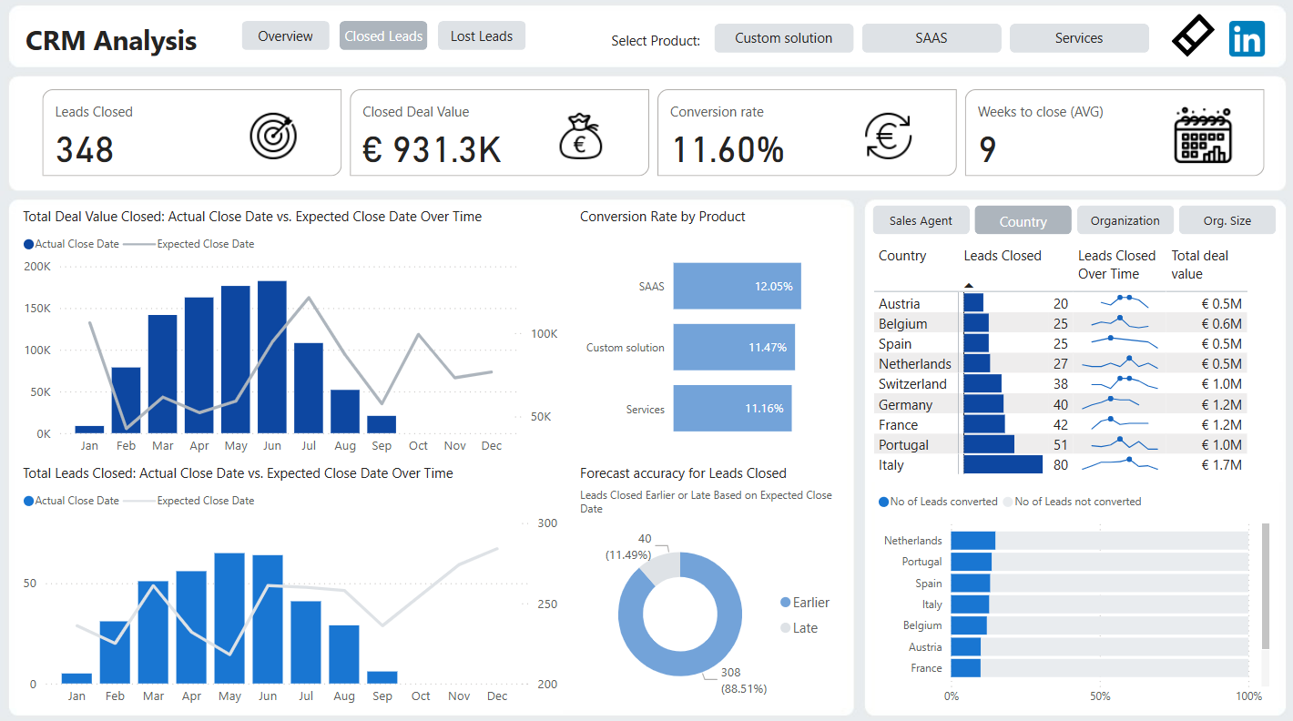
CRM Sales Dashboard – FP20 Data Challenge
Link to Linkedin post by Fernanda Goularte

Slide 16
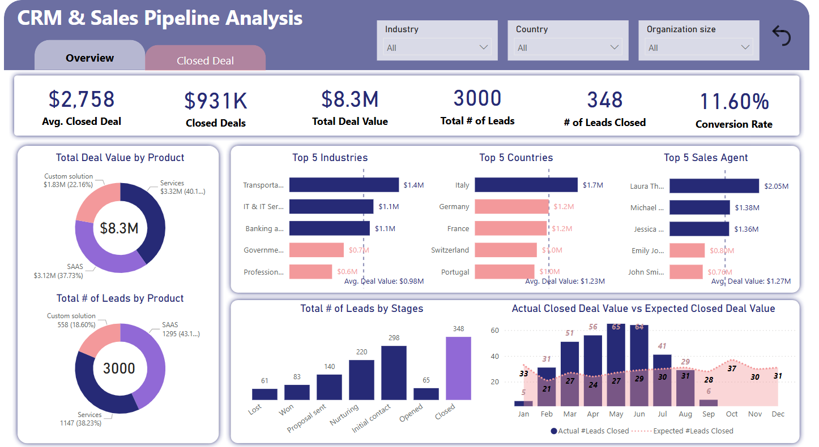
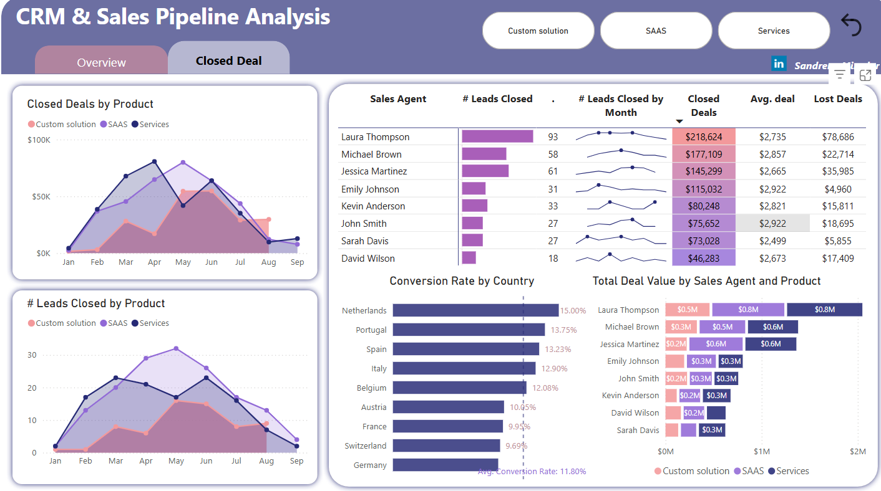
CRM Sales Dashboard – FP20 Data Challenge
Link to Linkedin post by Sandrene Mirado

Slide 17
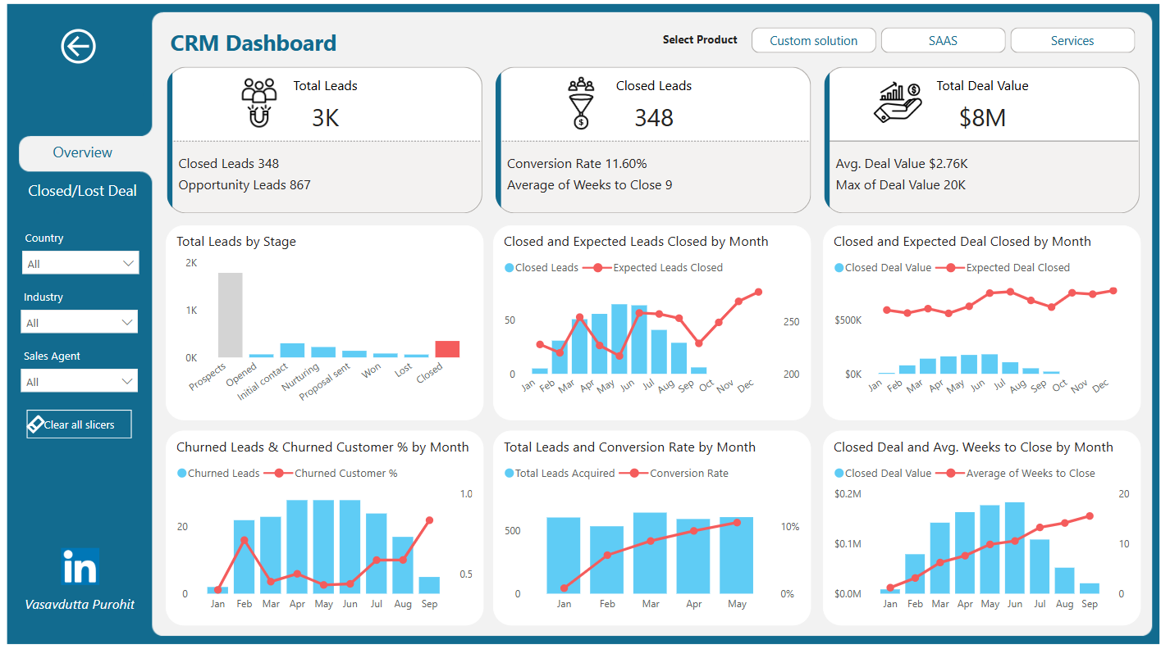
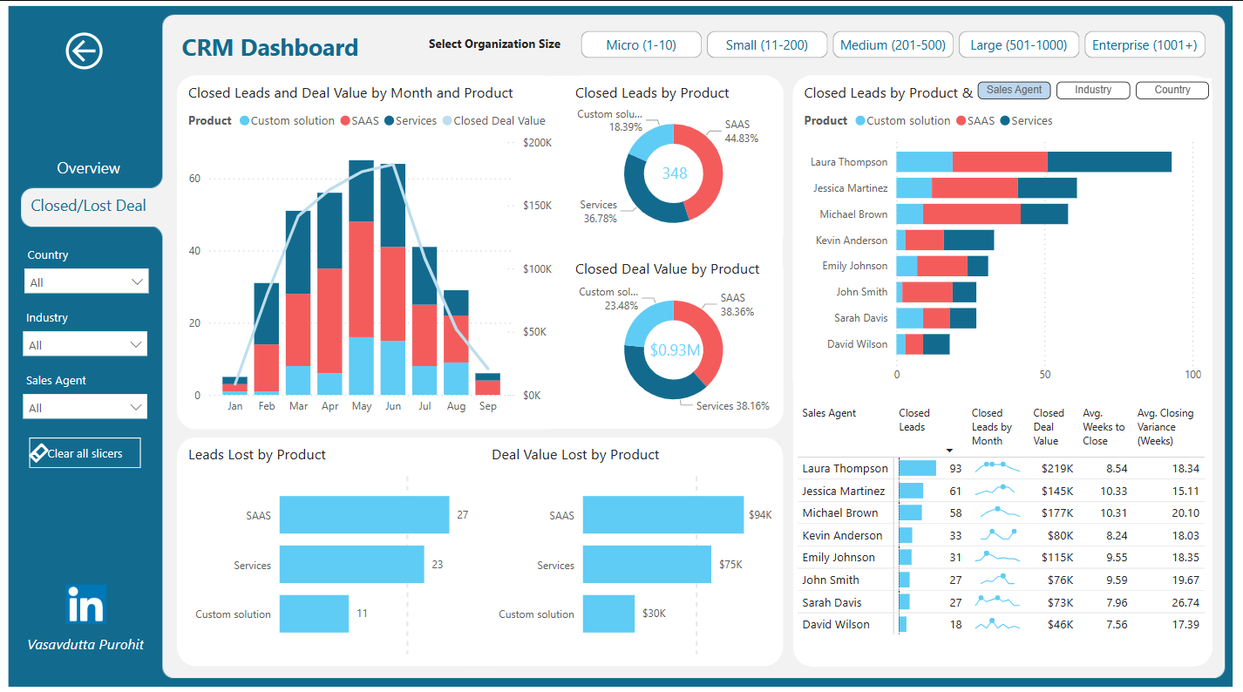
CRM Sales Dashboard – FP20 Data Challenge
Link to Linkedin post by Vasavdutta Purohit

Slide 18
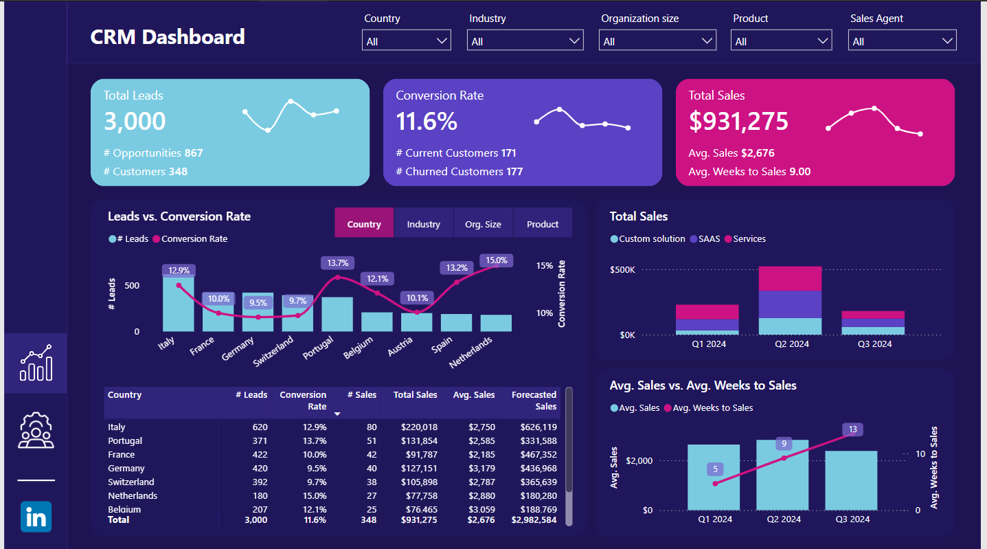
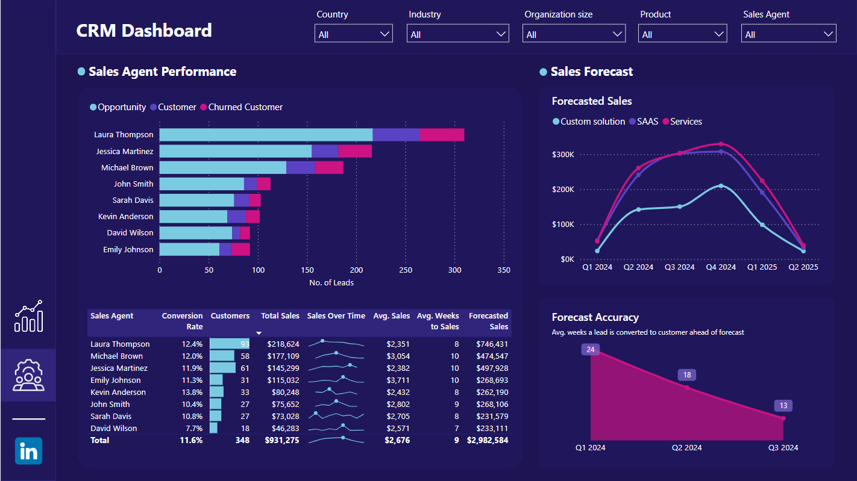
CRM Sales Dashboard – FP20 Data Challenge
Link to Linkedin post by My Dang

Slide 19
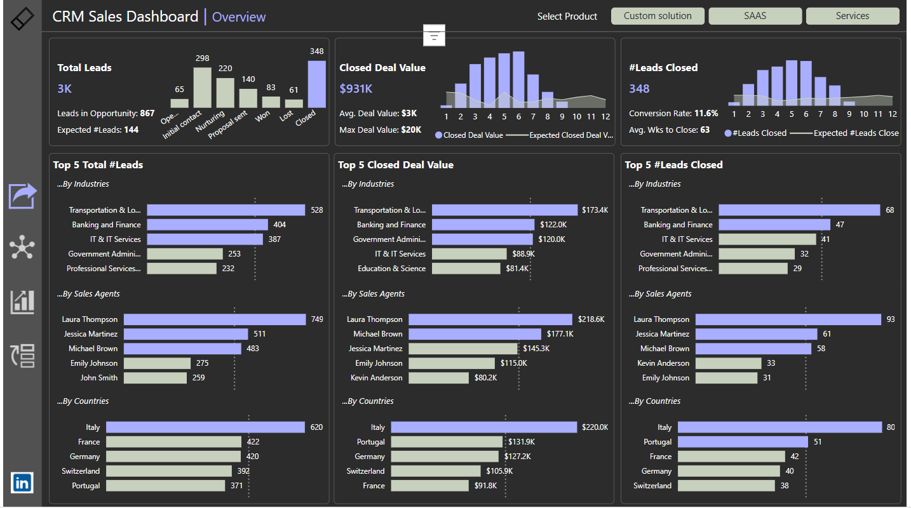
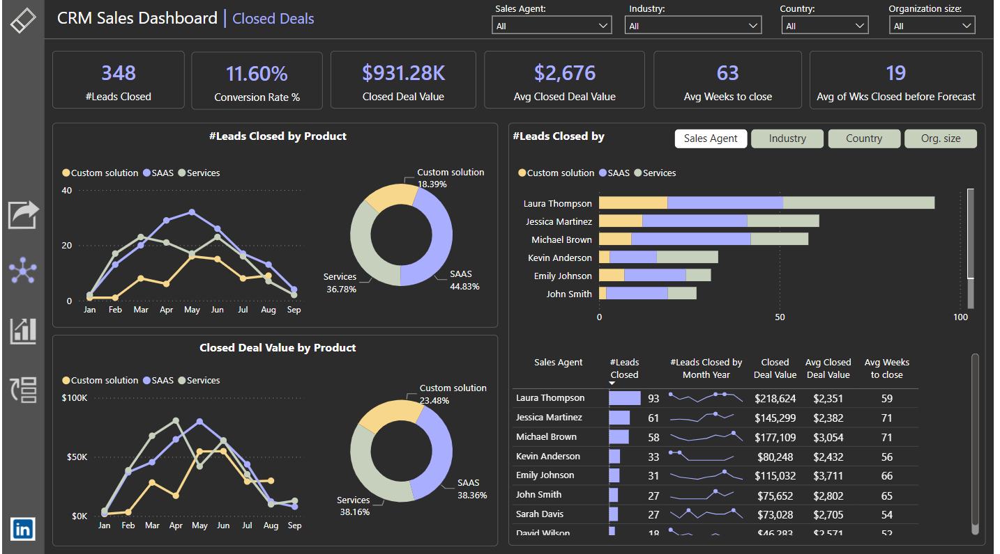
CRM Sales Dashboard – FP20 Data Challenge
Link to Linkedin post by Chidera Ozoh

Slide 20
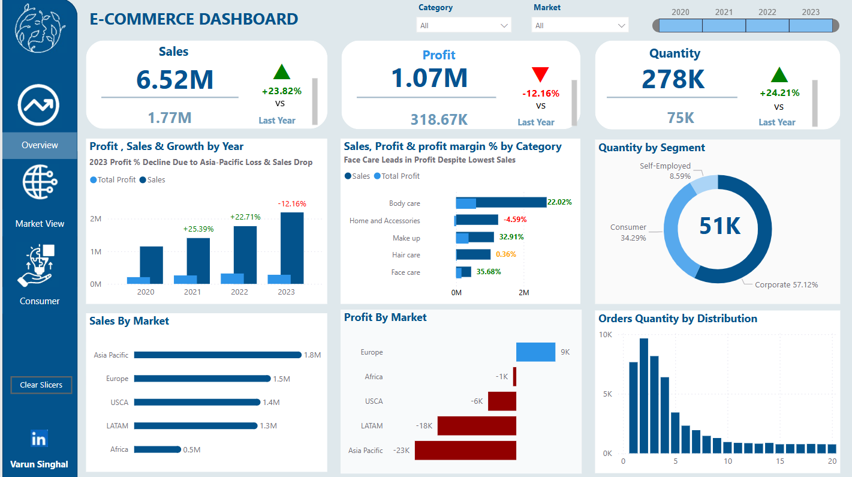
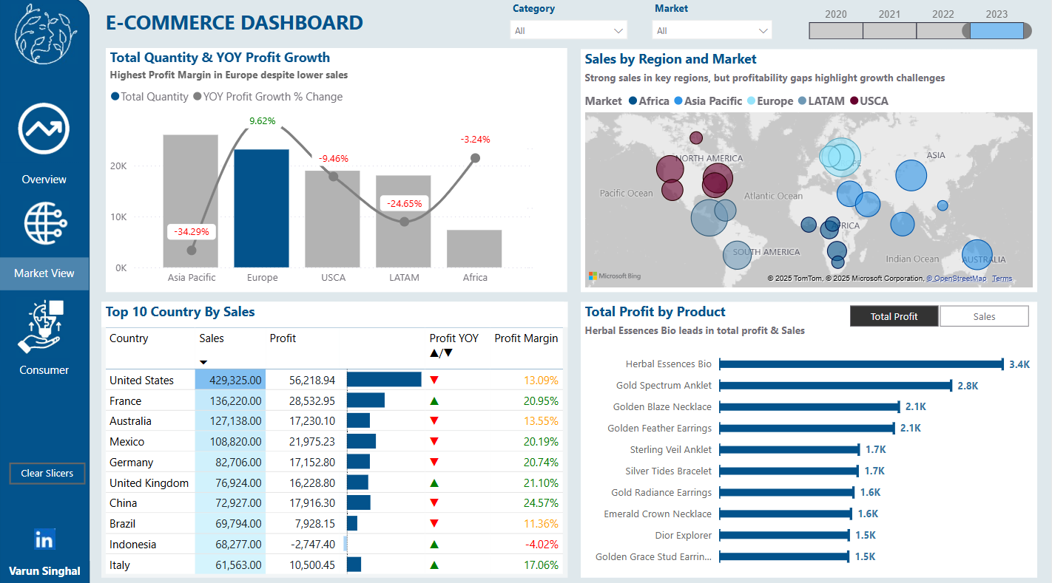
CRM Sales Dashboard – FP20 Data Challenge
Link to Linkedin post by Varun Singhal

Slide 21
Thank you!
Anh Leimer
Any questions please contact me via:
Email: anh.leimer@gmail.com
Linkedin: Anh Leimer

